Slide 1


Parking Management
System
Python Python
By, Akshi Vishnoi
2100290140018

Slide 2



INTRODUCTION ABOUT THE COMPANY
Founders :
Founded in 2009, JTG is led by Amit Yadav (CTO) and Rishu Gupta(CEO)
Mission :
“To grow our BUSINESS by providing quality products and services at great value when and where our customers want them, and by building positive, lasting relationships with our customers”
“ To be the preferred and most trusted resource for the products and services that enhance home and family life.”
Vision:

Slide 3
A quality analyst helps ensure that an organization’s products or services meet its quality standards
A quality analyst frequently reviews product or service specifications as a part of her role
Software Quality Analyst
A quality analyst will be responsible for the quality of the product To make the product bug free and flawless

Slide 4
Index
Project Worked
Objective
Modules
Pemit Management
Estate Management
Enforcement
Software and Tools Used
JIRA
KIWI TCMS
Postman
Slack
Sentry

Slide 5


Fintech Application
Projects Worked
Management

Slide 6
OBJECTIVE
The aim of implementing Parking Management System is to reduce time and increase efficiency of the current Parking Management System.
In overpopulated cosmopolitan zones, parking strategies must be well implemented for management of vehicles.
The system provides details of the vacant parking slots in the vicinity and reduces the traffic issues due to illegal parking in the vicinity.
It is designed with an objective to meet the requirements of controlled parking that offers effortless parking tactics to the authorities.

Slide 7
Modules

Slide 8
Permit Management
Provides user to apply for the permit using multiple permit form templates. On user application admin has a permission to approve or reject the application. He can assign the application to the permit group defined at particular site and car park.
Platform provides three different types of permit payments -
Pay by card
Pay by Google pay/ Apple pay
Direct debit(BACS model): Subscription based model

Slide 9
Estate Management
A module where the activities of Manco, Clients, Sites, Car Parks, Devices can be monitored and handled.
These sub-sections of estate management are the organizing entities who organize the parking related activities/facilities of Users. All these sections work in a hierarchical way that will be:
Manco
Client
Site
Car Park

Slide 10
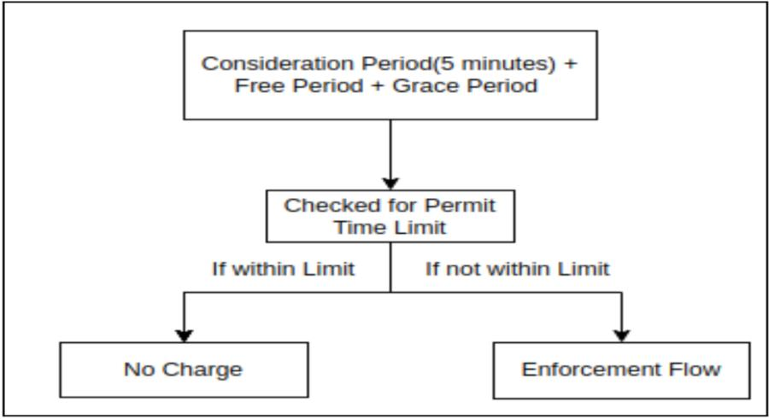
Estate Management

Slide 11
Enforcement
The process directed towards collection of the payments and entails issuing documents to contravention based on the regulatory and client requirements is called Enforcement.
Platform provides three different types of Enforcement payments -
Pay by card
Pay by Google pay/ Apple pay
Direct debit(BACS model): Subscription based model

Slide 12
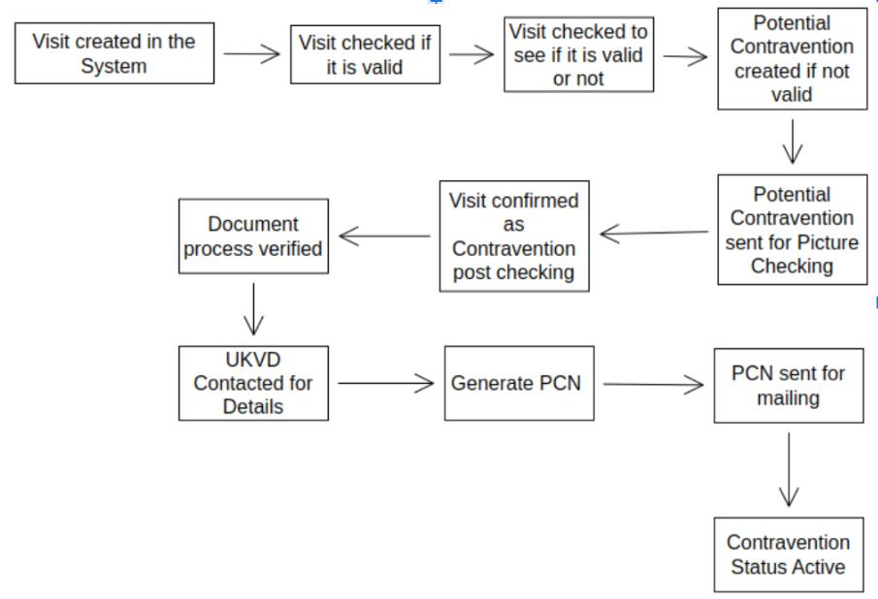
Enforcement

Slide 13







SOFTWARE/ TOOLS

Slide 14
Activities / Equipment Handled
JIRA
Used for issue tracking and project management Confluence documents
Dashboards to monitor the trends
KIWI TCMS
Leading open source test management for testing
Gherkin format
Test Plans, Test cases and automation runs

Slide 15
POSTMAN
Collaboration platform for API development
Help you organize your API work and collaborate across your organization or across the world
Used for API testing
SLACK
collaboration hub that brings the right people, information and tools together to get work done.
Slack to connect their teams, unify their systems and drive their business forwards.

Slide 16
SENTRY
Can trace performance issues to poor-performing Cloud functions calls and slow database queries.
Monitoring the sentries and creating the bugs based on the sentries

Slide 17
THANK YOU

